Slide 1



Machine Learning Based House Price Prediction System(SGH082)
By :
Team Id : SGH000152
Team Members :
Kanwani Nirali Hitesh Bhai
Chaudhary Pinky Satbir Singh

Slide 2
Problem Domain
Main Objective : To predict the price of a house based on certain features like locality, price per sq. feet, no. of rooms, age of house etc using Machine Learning Algorithms.
Expected Outcome : A machine Learning based software which takes values of decisive factors as input and outputs the estimated price.

Slide 3
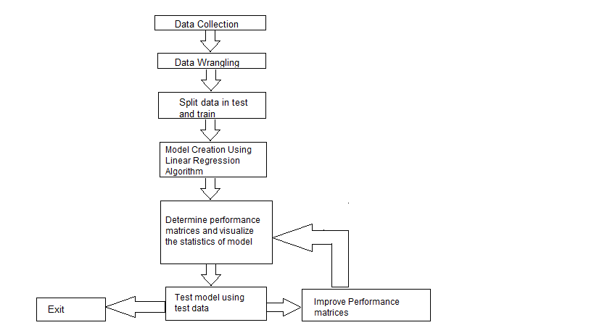
Basic Work-Flow For Solving the Given Problem Statement

Slide 4
Solution Approach
We referred different research papers from IEEE.
Find out the accuracy of the algorithms used in them.
Compared different algorithms based on accuracy.
Compared the different fields.
Tried to find the real-time dynamic data-set.
Tried to create a user-friendly web app using the available dataset that could predict accurate price.

Slide 5
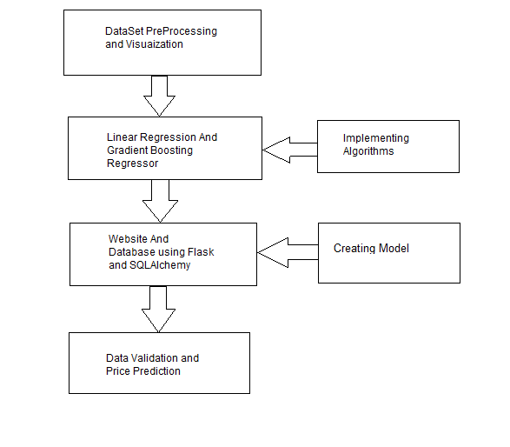
What we did

Slide 6
Technology We Used
Frontend : HTML , CSS , Bootstrap
Backend : Python and Machine Learning Algorithms
Framework : Flask
Validation : Through Java Script and Flask
Database : SQLAlchemy

Slide 7
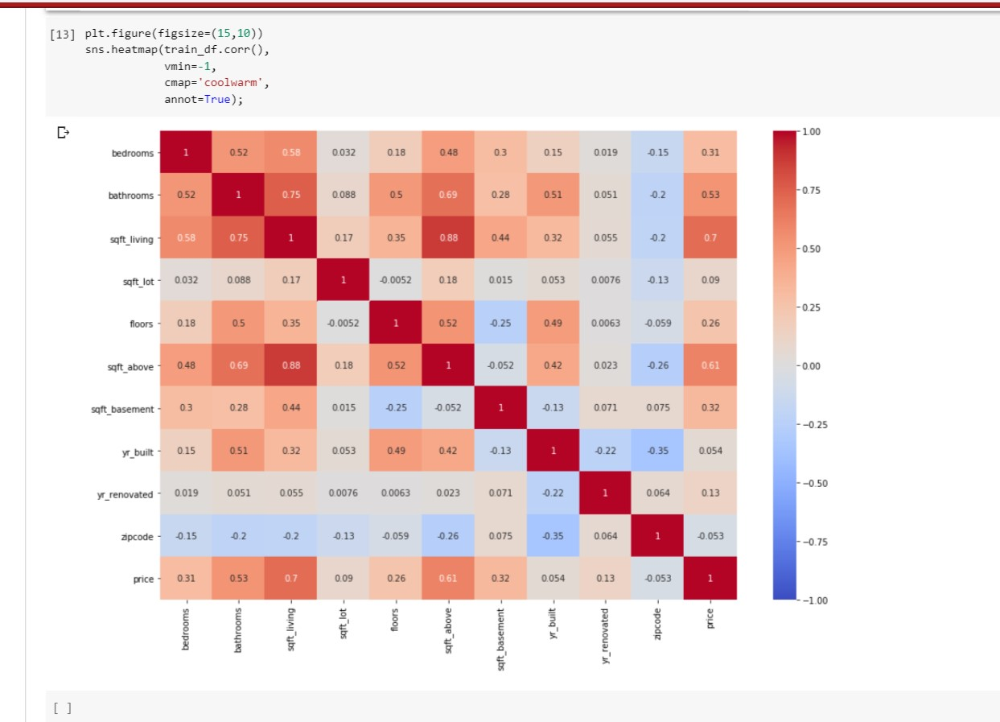
Correlation Heatmap for the used Dataset

Slide 8
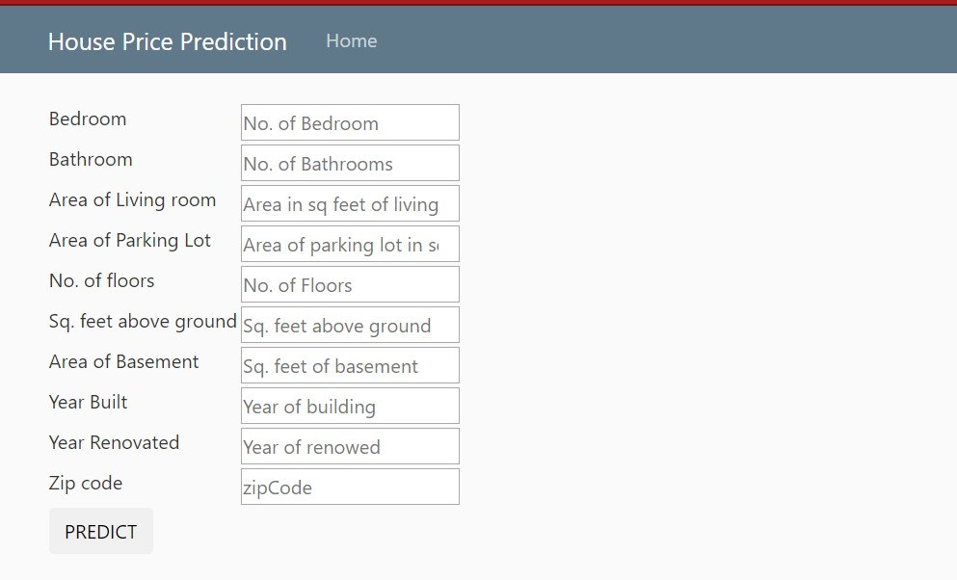
Parameter for User Input

Slide 9
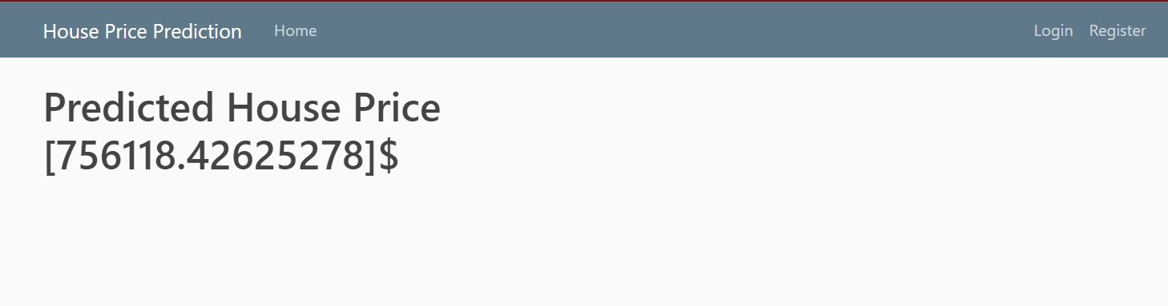
Our Final Result

Slide 10
Future Scopes
User-Friendly
Increase in parameters and accuracy of the model
Predicting outcome in graphical form
Dynamic Predictions by frequently updating datasets

Slide 11
THANK YOU

